Slide 1
USE CASE
ANALYSIS
Dr. Jose Annunziato

Slide 2
SOFTWARE REQUIREMENTS PROCESS
Business Requirements
the business need that drives the rest
why are we doing this
Deliverable: Vision and Scope Document
User Requirements
what are users trying to accomplish, goals
step by step description
Deliverable: Use Case Analysis Document
Functional Requirements
functionality that enables users accomplish their goal
Deliverable: Software Requirements Specification (SRS)

Slide 3
SOFTWARE REQUIREMENTS PROCESS
Business Rules affect Use Cases and Functional Requirements
Quality Attributes affect Functional Requirements and SRS, non functional reqs
Usability Reliability
Maintainability Supportability
Portability Testability
Scalability …ility
External Interfaces, Constraints
Living Documents
Waterfall / Agile / SCRUM

Slide 4
INTERVIEW PROCESS
Don’t ask
What do you want?
What are your requirements?
Focus on actual, abstract representative user goal
What are they trying to accomplish?
How do they envision using the system?
Focus on what the user wants to do, not what the system will do
Ask: What are you trying to accomplish/do?
I want to to be able to XXXX
I need to do XXXX

Slide 5
USE CASE ANALYSIS
System:
formal name and description of the system being designed
User Classes: communities of real people
Actors or System Actors
external entities or systems that interact with System
role
Use Cases
step by step general description of user interaction with System that result in measurable business value
Test Cases (?)

Slide 6
USE CASE
Describe
user goals
user's view of system
task related activities
Do not describe
technology
user interfaces ("click on ok" vs "submit")
implementation details

Slide 7
USE CASE EMPLATE(S)
Full Name Of Use Case [abreviatedName]
Description: prose describing user's goal
Precondition: any conditions that most be true
Steps: one or more of the following
[Actor] – action description prose
[System] – system reaction prose
[Other Actors] – action description prose
Post condition: state of the system at end
Alternate paths (scenarios): variations of the path and edge case conditions

Slide 8
USE CASE EMPLATE(S)
Use Case: View an Order
Actor: Customer
Preconditions:
Order exists
Customer authenticated
Actor Actions System Responses
User submits order # Order details displayed
User submits order # Error message: order
that does not exist number not found

Slide 9
USE CASE EMPLATE(S)
Use Case ID: ______ Use Case Name:______
Created By: ______ Updated By:_________
Date Created:_____ Updated When:______
Actors:__________
Description:______
Trigger:__________
Preconditions:_____ Post conditions:______
Normal Flow:______ Alternate Flows:______
Exceptions:_______ Includes:____________
Priority:__________ Frequency:__________
Business Rules: ____ Assumptions:________

Slide 10
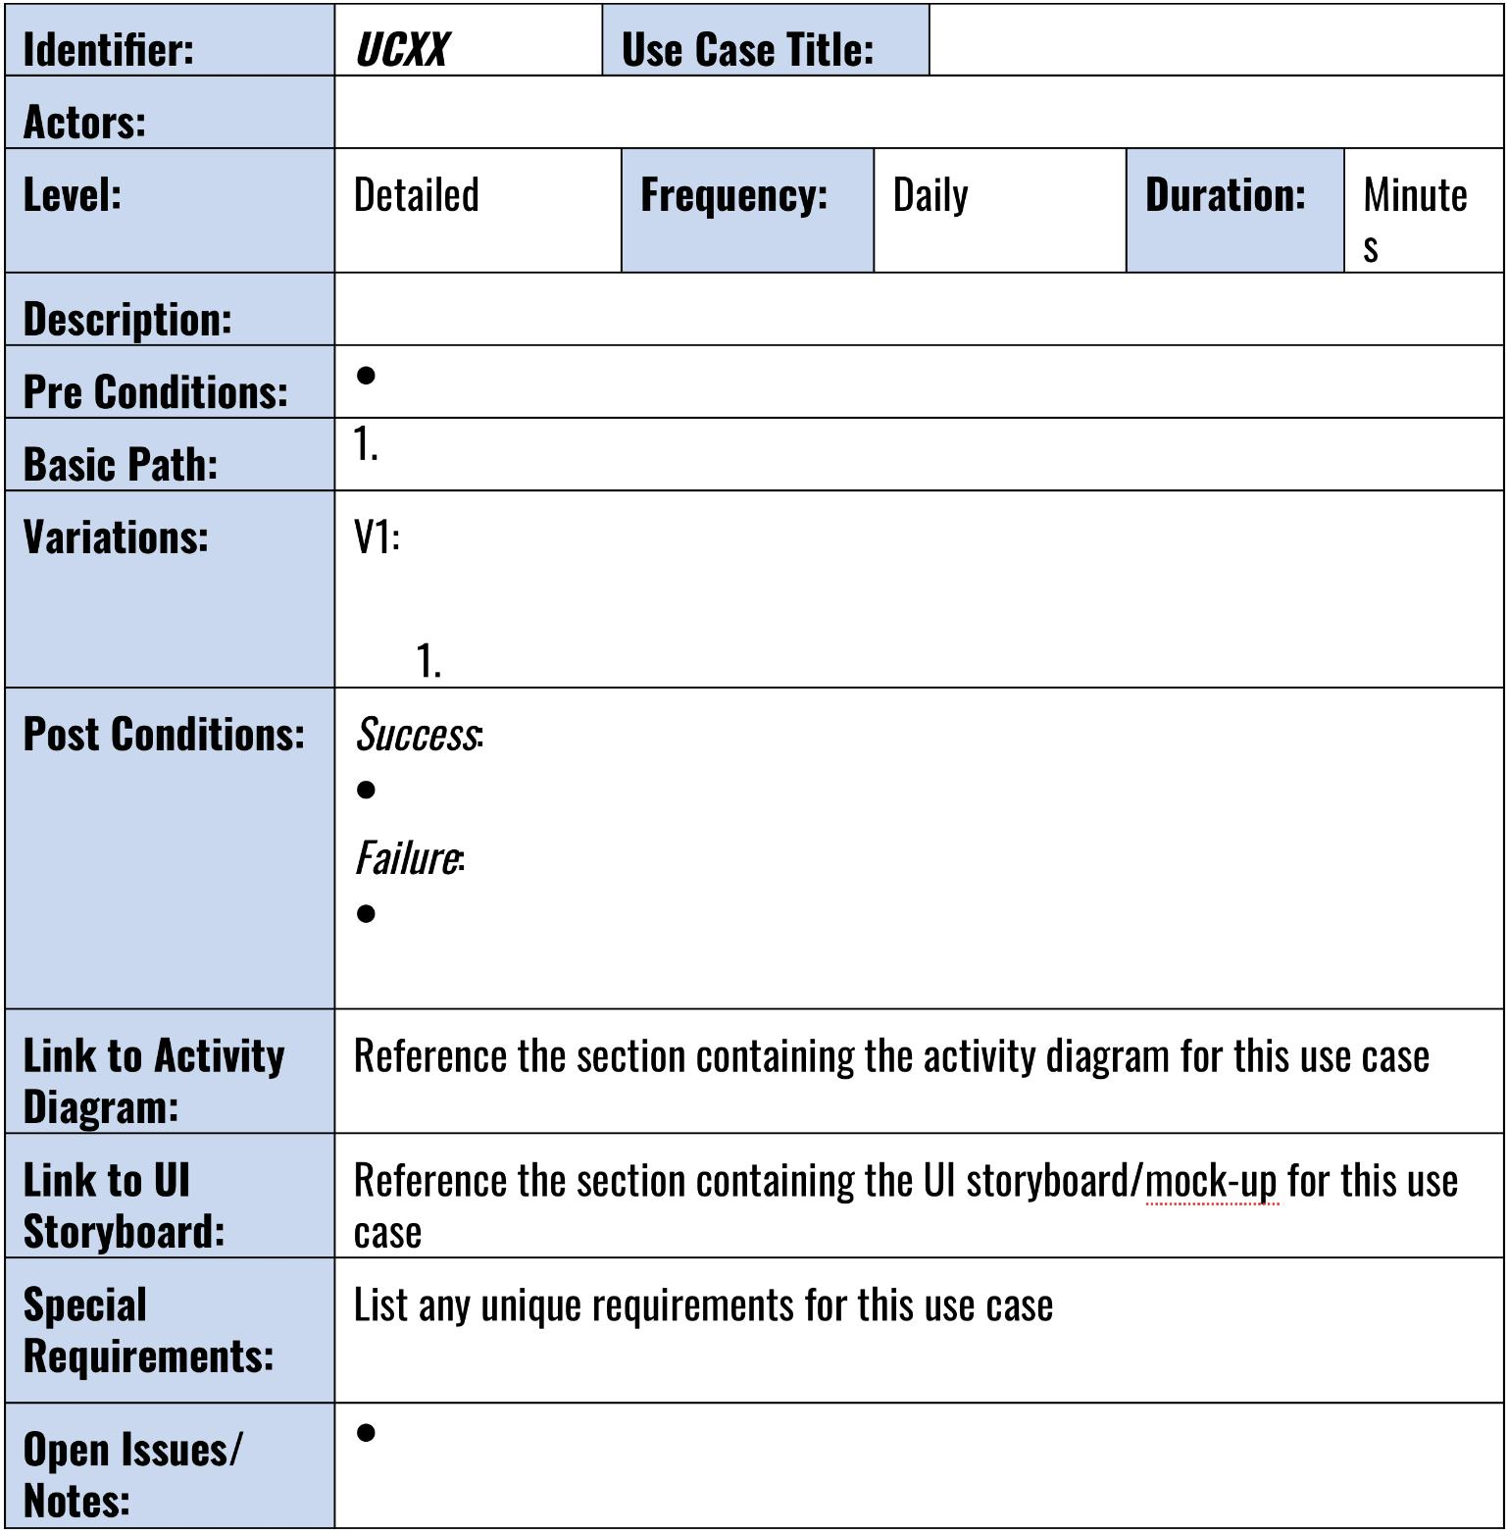
USE CASE EMPLATE(S)

Slide 11
USER STORIES
More verbose / general
Less granular than use case
Template
As an [Actor] I want to [action] so that [achievement]
Example
As a Google+ member, I want to create circles to set the privacy levels to control who sees what

Slide 12
USER SCENARIOS
Use cases can abstract several possible scenarios
Scenario is a specific instance or path through a use case
Happy path
Also alternative paths

Slide 13
USE CASE ANALYSIS PRODUCTS
Use Case Interviews
Use Case Descriptions
Draft SRS
Draft Tests
Draft Models
Business Rules
Data Dictionary

Slide 14
EXAMPLE USE CASES
Amazon.com orders
Track order Check status
Change shipping Cancel order
Change billing
Freshbooks.com accounting
Receive payment Create new client
Create invoice Write an expense
Online purchase
Add to shopping cart, Checkout…, Pay…
Search catalog Remove from shopping cart
Not: enter pin, login, submit form, process X

Slide 15
FISH 360 – USE CASE ANALYSIS
System
Name: Fish 360 [Fish360]
Authors: Johny B. Good, Billy Squire
Description: Social networking site for professional fishermen. Allows fishermen to plan fishing trips based on various data such as weather, tide, tips, and geography. Fishermen can log the fish that they catch as well as GPS, gear, and actual conditions
Organizations: National Oceanographic Association
Creation Date: May 11, 2017

Slide 16
SYSTEM ACTORS
Fisherman
Description: Plans fishing trips, takes pictures of the fish they catch, takes notes of their trip, posts their experience on the Web site
Kind Of: User
Sponsor
Description: Advertises on the Web site where to rent boats, buy bate, get something to eat, etc
Kind Of: End User
End User [User]
Description: End user of the system
Kind Of: User

Slide 17
USE CASE – SEARCH LOCATION
Fisherman Searches for Location [searchLocation]
Description: the fisherman enters cities, towns, states, addresses, zips searching for fishing information about a location
Preconditions: Fisherman knows address
Step by Step:
Fisherman – enters a location as a ZIP code or lat/long
Fish360 – responds with a map of locations of interest
Fisherman – selects a location of interest
Fish360 – displays details about the location of interest
Fisherman - confirms selection or dismisses selection

Slide 18
USE CASE – PLAN TRIP
Fisherman Plans a Trip [planTrip]
Description: fisher selects dates and location for the trip, as well as invites other participants
Actors: Fisher, OtherFishermen
Step by step:
Fisherman – selects location and dates for trip
Fish360 – stores new trip, makes an entry in the calendar, notifies other fisher
OtherFishermen – fishers receive notification and accept or decline
Fish360 – notifies inviter of acceptance, makes an entry in the calendar

Slide 19
USE CASE – CREATE FISH
Fisherman Creates a Fish [createFish]
Description: fisherman uploads images of the fish they caught, their weight, length and gear they used
Step by step:
Fisherman – selects a trip they had planned
Fish360 – displays details of the trip
Fisherman – requests a list of the fish from the trip
Fish360 – displays a list of the fish
Fisherman – adds a new fish to the list, entering details about weight, length, gear used, and (optional) location
Fish360 – displays a list of the fish with new fish in the list

Slide 20
USE CASE
DIAGRAMS
Dr. Jose Annunziato

Slide 21
FISH 360
search location
create store
plan trip
create products
create account
fisher
update
profile
sponsor
create gear
create ad
create fish entry

Slide 22
FISH 360
search location
create store
plan trip
create products
create account
<<includes>>
validate identity
<<includes>>
fisher
update
profile
sponsor
create gear
create add
create fish entry

Slide 23
ONLINE COURSE MANAGEMENT
System
Name: Online Course Management [OCM]
Authors: Markus Persson
Description: Online system allowing professors to create and manage online courses, create questions, quizzes, and various teaching elements
Organizations: Metropolitan University
Creation Date: September 23, 2016

Slide 24
SYSTEM ACTORS
Faculty [Faculty]
Description: Creates, plans courses for a particular topic as well as types of teaching elements and evaluations
Kind Of: User
Course Manager [CourseManager]
Description: Translates the courses created by the faculty into actual online courses using the various teaching element tools provided by the system
Kind Of: End User
Student [Student]
Description: Uses the system to learn
Kind Of: User

Slide 25
USE CASE – CREATE COURSE
Faculty Creates Course [createCourse]
Description:
Step by Step:
Faculty lists current courses
Faculty selects New Course
Faculty enters course title
Faculty enters description

Slide 26
ONLINE COURSE MANAGEMENT
enroll in a course
prepare assignment
view grades
prepare quiz
prepare final
Student
Faculty
grade assignment
take an exam
work on project

Slide 27
ONLINE COURSE MANAGEMENT
enroll in a course
prepare assignment
<<extends>>
view grades
prepare quiz
creates
evaluation
prepare final
Student
Faculty
grade assignment
take an exam
<<extends>>
completes
evaluation
work on project
<<extends>>

Slide 28
ATM
open account
withdraw cash
deposit money
Account
Owner
transfer money
close account

Slide 29
USE CASE – WITHDRAW CASH
Client Withdraws Cash (withdrawCash)
Description: AccountOwner withdraws cash from specific account
Preconditions: AccountOwner's identity is validated, Account has positive balance, ATM has enough cash
Post conditions: Cash has been dispensed, Balance decremented by amount
Step by Step:
Account Owner ATM
Identifies themselves displays AccountOwner's accounts
Selects account asks for amount
Chooses amount dispenses cash
Removes cash

Slide 30
USE CASE – WITHDRAW CASH
Client Withdraws Cash (withdrawCash) (continued…)
Alternate flows:
Chooses custom amount
Describe where branching occurs, detailed steps, where rejoins main flow
Exceptions: would stop actor from achieving goal
multiples of $20
exceed daily withdrawal limit
exceed account balance
exceed cash in ATM
Note step where exception occurs and how system handles it
Don’t assume developer will know what to do

Slide 31
FUNCTIONAL REQUIREMENTS
Use cases are user's view of system
Functional requirements are developer's view
Translate use cases into functional requirements
Documentation
Use cases are not enough for developers

Slide 32
USE CASE → FUNCTIONAL REQUIREMENTS
Precondition
System shall verify account set up for ATM withdrawals
What if this is not true?
Step
System shall display list of standard withdrawal amounts
User shall select one of these amounts
Postcondition
System shall reduce total cash in ATM by amount
Business Rule
System shall print receipt, unless account is business

Slide 33
Use Cases → SRS
Use Cases SRS
Precondition
~~~~~~~~~~~~~~~~~
~~~~~~~ ~~~ ~~~~
~~~~ ~~~~~ ~~~~~~
~~~~~~~~~~~~~~~~~~~
~~~~~~~~~~~~~~~~~~~
~~~~~ ~~~~~ ~~~~
~~~~~~~~~~~~~~~~~~
~~~~~~~~~~~~~~~~~~~
~~~~~~~~~~~~~~
~~~~~~~~~~~~~~~~~~
~~~~~~~~~~~~~~~~~~~
Normal Flow
Alternate
Alternate
Alternate
Exception
Exception
Exception
Postcondition
Rules

Slide 34
Page Editor
create page
create script
create data
create website
manage users

Slide 35
Telecommunication Tower Operator
search tower
apply for tower
view progress
update progress

Slide 36
University
enroll in a course
evaluate students
take an exam
prepare exam
work on project
Student
grade assignment
Professor
view grades
login

Slide 37
University
enroll in a course
prepare assignment
take an exam
prepare quiz
work on project
prepare final
Student
Professor
view grades
grade assignment
login

